Slide 1
The Mensural Scoring-up Tool
Martha E. Thomae, Julie E. Cumming, and Ichiro Fujinaga
Schulich School of Music, McGill University
Digital Libraries for Musicology (DLfM)
The Hague, November 09, 2019
Notes:
[Next Slide Beg:] THIS TOOL IS MEANT TO WORK WITH MENSURAL MUSIC. Mensural music refers to vocal polyphonic music written between the 1250s and the 1600s, which used an older system of music notation called “mensural notation”
HERE WE HAVE an example of a mensural piece [Click!]

Slide 2
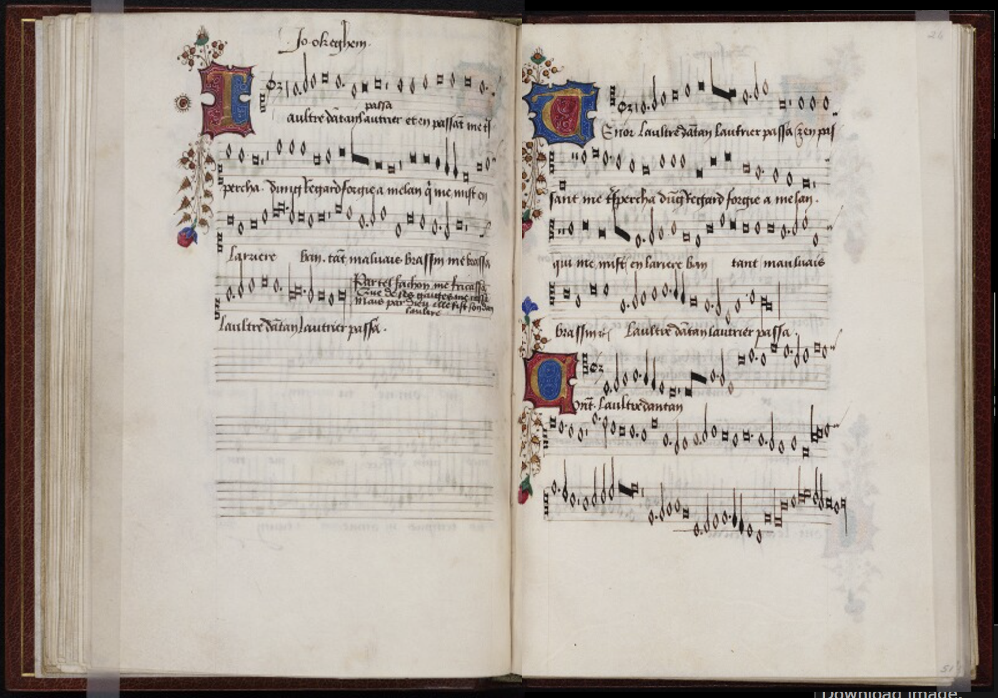
Superius
Tenor
Beinecke Rare Book and Manuscript Library,
Yale University
Mellon Chansonnier (MS 91),
25v-26r
Contratenor
Notes:
Most mensural music was written in separate parts
the voices are presented separately: in different areas of the page or in books
You can see that in this example
So here we have the opening of a book
That contains a single piece -> This is L’Autre D’Antan by Ockeghem -> It is a mid-fifteenth century piece
Each of the 3 voices lies on a different area of the opening
S, T, C
This separate arrangement of the voices makes it harder to analyze this music:
While you have all the melodic information of each voice
You cannot visualize the vertical sonorities that easily, because the notes are not lined-up (as will be the case if the voices were presented in score format)
The purpose of this project is to take ALL the notes from each of the mensural parts (i.e., voices) and line them up automatically [CLICK!] → TO PRESENT THE PIECE in score format

Slide 3
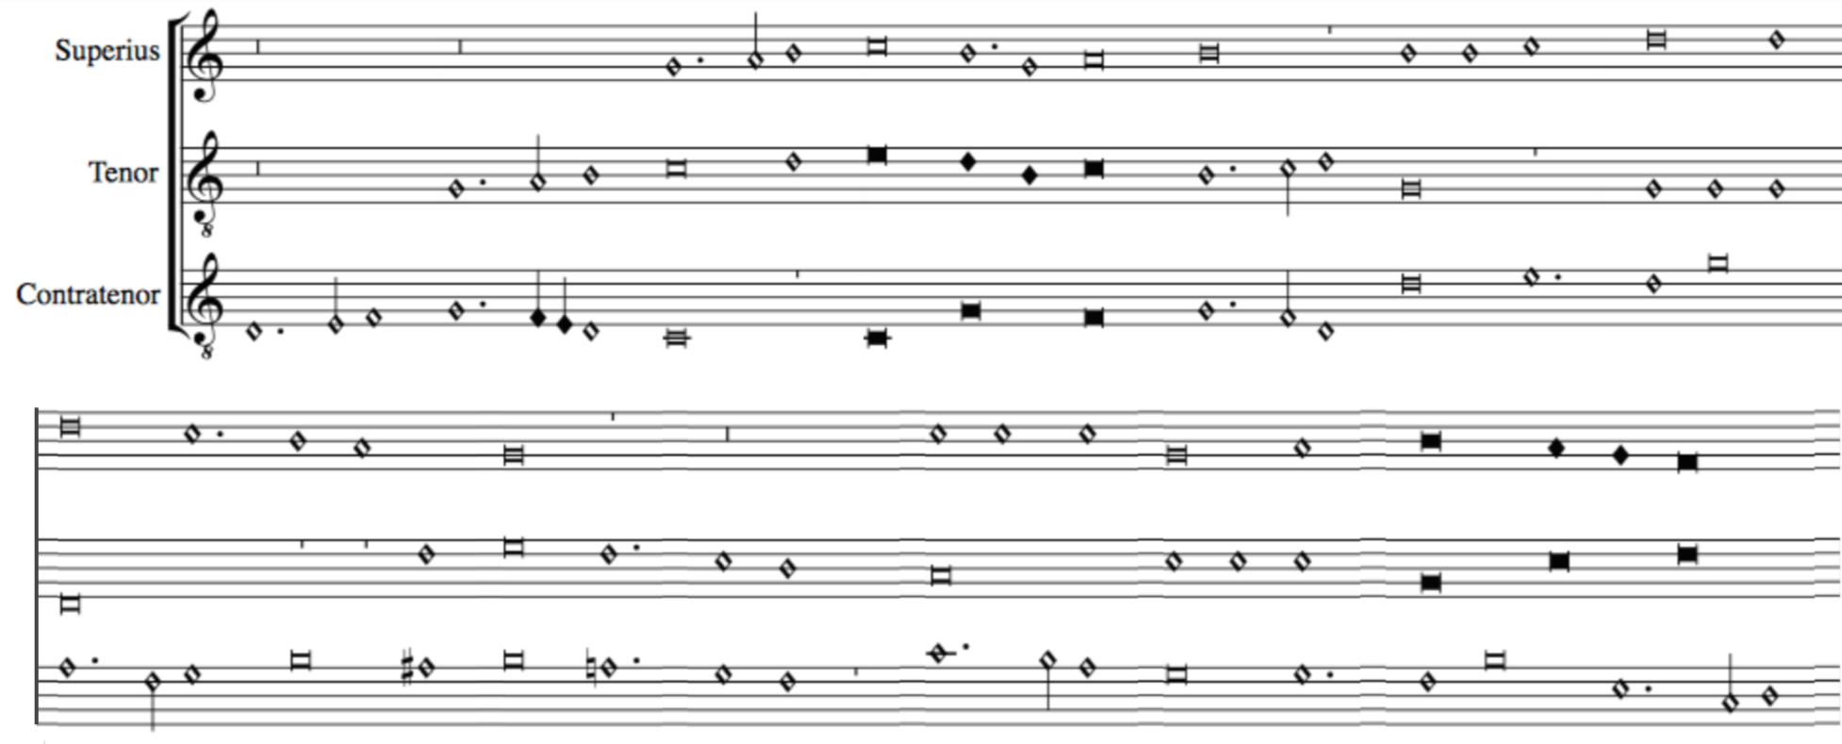
Scoring up
Notes:
TO PRESENT THE PIECE in score format
We REFER to this process as SCORING UP
We are developing an Automatic Scoring-Up Tool
To facilitate counterpoint studies (this is, the study of the relation between the voices)
So, even though the TASK of the "scoring-up tool" SEEMS PRETTY SIMPLE (just lining-up the notes of the different voices), it is COMPLICATED BY THE NATURE OF THE NOTATION ITSELF.
[CLICK!] So lets talk about mensural notation...

Slide 4
Mensural Notation (An Introduction)
Notes:
So lets talk about mensural notation..

Slide 5
Beinecke Rare Book and Manuscript Library, Yale University
Mellon Chansonnier (MS 91), 25v-26r
Notes:
Mensural notation is the immediate predecessor of our Common Western Music Notation system, and when IT started, we already had an EXPLICIT way to notate PITCH:
Staff-lines
Clefs
But the same did not applied to rhythm yet.
1. We already had DIFFERENT NOTE-SHAPES as you can see here, BUT they did not EXPLICITLY conveyed the duration of the note.
2. Ambiguity in their interpretation
3. This AMBIGUITY of the note DURATION COMPLICATES the SCORING-UP TASK, because in order to line the notes up we need to know their duration.

Slide 6
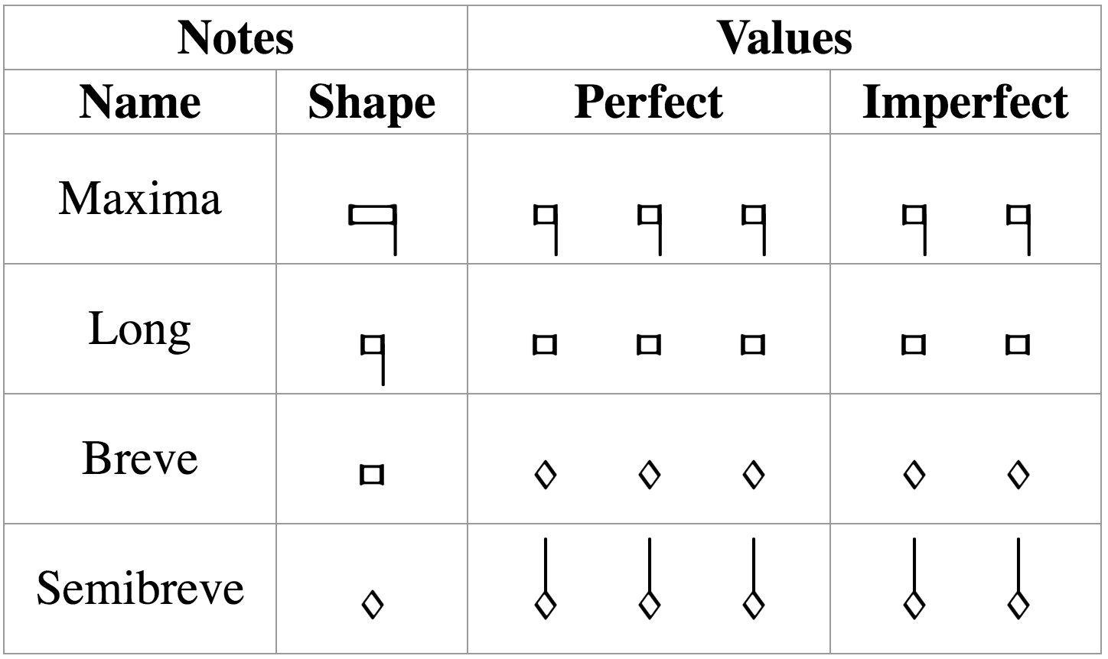
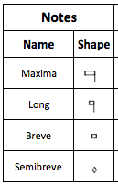
Mensural Notation
There is a clear hierarchy in the note duration
longest
shortest
Mensuration
Establishes the relation between the note values (“perfect” or “imperfect”)
3 x 2 x 1 x 3 x
Notes:
So what is this ambiguity I am talking about?
Each note shape can have two different values, it can be ternary (perfect) or binary (imperfect).
So we have examples like ... in which (3, 2)
So, how do we know what is the value of a note?
We have this REALLY IMPORTANT concept in mensural notation: MENSURATION
In imperfect mensuration → there is no ambiguity regarding the duration of the notes
The challenge occurs when dealing with PERFECT MENSURATION at ANY OF THESE FOUR NOTE-LEVELS. [CHANGE SLIDE]

Slide 7
In perfect mensurations, the duration of the individual note symbols is not absolute, but rather depends on context
Notes:
The MENSURATION gives us a semifixed relation between the duration of the notes, but that relation can be changed by the context (I.E., THE NOTES AROUND)
AND IT IS THIS CONTEXT-DEPENDENCY ISSUE THAT IS THE MAIN FOCUS OF THE SCORING-UP TOOL
There are certain principles on how context affects the note value. I will give an example of a few of them to illustrate the general idea behind them.

Slide 8
Examples of Context Changing the Note’s Duration
Mensuration: Breve = 3 → Breves are perfect by default
Principles of
Imperfection
and Alteration
Imperfection
Perfect → Imperfect
Alteration
x 2
Franco of Cologne
Ars Cantus Mensurabilis (ca. 1280)
Notes:
1. This breve is perfect, this breve is perfect, and so on…
2. That is the idea in perfect mensuration, WE HAVE TRIPLE METER, we move in a series of perfections
3. [green square] Two modifications
4. [Principles!] --> Outlined by Franco of Cologne (ca. 1280)
5. Written in terms of these kinds of sequences --> delimited by notes that are supposed to be perfect --> number of notes --> modification.
6. So the scoring-up DEALS with the CONTEXT-DEPENDENT nature of mensural notation by IMPLEMENTING these PRINCIPLES of IMP and ALT

Slide 9
The Scoring-up Tool
Notes:
Lets walk through the algorithm that implements these principles --> By using an example

Slide 10
Algorithm
Mensuration: Breve = 3 → Breves are perfect by default
Notes:
BOUNDING BY PAIRS OF BREVES!!!
[BEG] Lets say we have the mensuration… which indicates that by default …
Steps:
1. Divide the notes into sequences of the form we saw in the previous slide.
Find all the breves
Find all the sequences that are bounded by those breves…
2. For each of those sequences we get the number of semibreves, since that will indicate the modification that we have to perform.
So lets take one of such sequences as an example

Slide 11
Example: (sequence bounded by breves)
1
2
3
4
5
6
7
7 semibreves = Two groups of 3 semibreves + 1
Example in perfect tempus and minor prolatio
Notes:
So lets take one of such sequences as an example
So here we have 7 semibreves
And what we do is that we group those 7 semibreves into perfect groups (groups of 3 semibreves) and see HOW MANY ARE LEFT OUT
The remainder can only be 1, 2, or None

Slide 12
Number N of semibreves between the boundaries | Number P of perfect groups of semibreves | General Interpretation | Alternative Interpretation
N = 3P + 1 | P >= 0 | Imperfection (by following) | Imperfection (by preceding)
N = 3P + 2 | P = 0 | Alteration | Imperfection (by following) & Imperfection (by preceding)
 | P > 0 | Imperfection (by following) & Imperfection (by preceding) | Alteration
N = 3P | P = 0 | - | -
 | P = 1 |  | Imperfection (by following) & Alteration
 | P > 1 | Imperfection (by following) & Alteration | -
Notes:
3 Remainders
Type of modification (Imperfection, Alteration, Both, or None)

Slide 13
Number N of semibreves between the boundaries | Number P of perfect groups of semibreves | General Interpretation | Alternative Interpretation
N = 3P + 1 | P >= 0 | Imperfection (by following) | Imperfection (by preceding)
N = 3P + 2 | P = 0 | Alteration | Imperfection (by following) & Imperfection (by preceding)
 | P > 0 | Imperfection (by following) & Imperfection (by preceding) | Alteration
N = 3P | P = 0 | - | -
 | P = 1 |  | Imperfection (by following) & Alteration
 | P > 1 | Imperfection (by following) & Alteration | -
Notes:
General interpretation
Situations that do not allow for this [general] interpretation, and FORCE an alternative interpretation:
Dots of division
Rests

Slide 14
Example: (sequence bounded by breves)
1
2
3
4
5
6
7
7 semibreves = Two groups of 3 semibreves + 1
Example in perfect tempus and minor prolatio
Notes:
Continuing with our example
→ General interpretation according to the previous table would be …
FIRST IMP by the notes that FOLLOW
→ Interpretation
[click]
But as I said,
Situations that do not allow for this interpretation, and force an alternative interpretation:
Most common one → [CLICK!] DOTS OF DIVISION

Slide 15
Example: (sequence bounded by breves)
DOT OF DIVISION
1
2
3
4
5
6
7
7 semibreves = Two groups of 3 semibreves + 1
Example in perfect tempus and minor prolatio
Notes:
→ DOTS OF DIVISION
Used to indicate that the notes belong to different perfections
Use a DOT OF DIVISION between … to indicate that they belong to different perfections
➔ So they CANNOT be GROUPED this way anymore!

Slide 16
Example: (sequence bounded by breves)
DOT OF DIVISION
1
2
3
4
5
6
7
7 semibreves = Two groups of 3 semibreves + 1
Example in perfect tempus and minor prolatio
Notes:
Instead, the grouping would be
=> Now the LAST is IMP by the notes PRECEDING

Slide 17
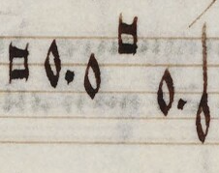
Scoring-up Tool
Deals with the context-dependent nature of mensural notation
By implementing the “principles of imperfection and alteration”
Deals with other non-context-related features:
Dots of augmentation
Coloration
When?
Distinguish between “dots of division” and “dots of augmentation”
division
augmentation
Notes:
[START Content of the Slide]
[In Non-Context Related Features]
Dots of augmentation are …
Coloration is ...
Difficult part ...

Slide 18
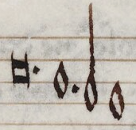
Scoring-up Tool
Deals with the context-dependent nature of mensural notation
By implementing the “principles of imperfection and alteration”
Deals with other non-context-related features:
Dots of augmentation
Coloration
division
When?
Distinguish between “dots of division” and “dots of augmentation”
augmentation
When does coloration affect the note value?
Notes:
So, just to show you how the scoring-up tool works

Slide 19
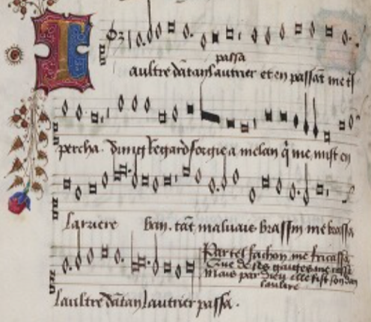
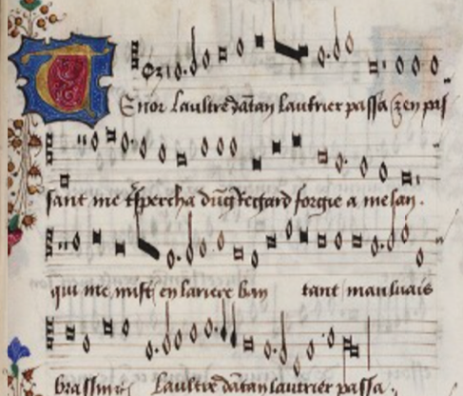
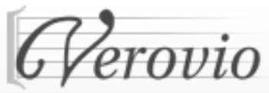
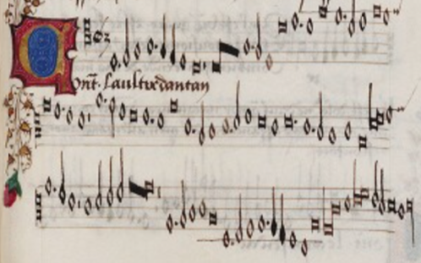
Scoring-up Tool
Pitch
Note shape
Mensural MEI file
_______
_______
Mensural Scoring-up
Tool
Determine note duration based on contextual and non-contextual cues
Merge all files together
Mensural
MEI file
________
________
________
________
Superius part
Mensural MEI file
_______
_______
Tenor part
SCORE
Mensural MEI file
_______
_______
Contratenor part
Notes:
We have these Mensural MEI files encoding all the notes in each voice
Two types of information regarding the notes:
Pitch and the note-shape
NO DURATION VALUE INFO
ScUp --> Finds out whether a note has its default duration or it has been modified (by imperfection, alteration, or augmentation) BASED ON CONTEXTUAL & NON-CONTEXTUAL CUES
And it includes that information for each note in each of the voices.
Merges
MEI
VEROVIO: Software that allows to display the actual music encoded in these MEI files.

Slide 20
Data used for the Experiment
Pieces from the XIV and XV Centuries
Century | Project | Format | Composers and Sources | Number of Pieces
XIV | Measuring Polyphony Project (Karen Desmond http://measuringpolyphony.org) | Mensural MEI | Vitry, Machaut, Anonymous (Ivrea Codex) | 8
XV | Josquin Research Project (Jesse Rodin, Craig Sapp, Clare Bokulich) | Modern transcriptions converted into Mensural MEI using: SibMEI + Mensural MEI Translator | Du Fay and Ockeghem (GB-Ob, Dijon, Mellon, Laborde, Wolfenbüttel) | Du Fay: 5 Ockeghem: 5

Slide 21
Results
Accuracy: 98%
Only 55 mislabeled notes out of 2866 notes of ambiguous duration
Most common source of error: absence of the dot of division
Notes:
The accuracy was not calculated over all the notes, because not all of them are ambiguous
But only on the ambiguous ones (the ones where the algorithm had to made a decision as to whether they were perfect / imperfect, regular / altered, a decision regarding the type of dot: division / augmentation, or whether the coloration had an effect / not in the note duration)

Slide 22
Example: Three Separate Parts
Notes:
15th Century OCKEGHEMS’ piece (L’autre D’antan)
Input files → Voices
Barlines → PERFECT GROUPINGS! → places where the voices must coincide

Slide 23
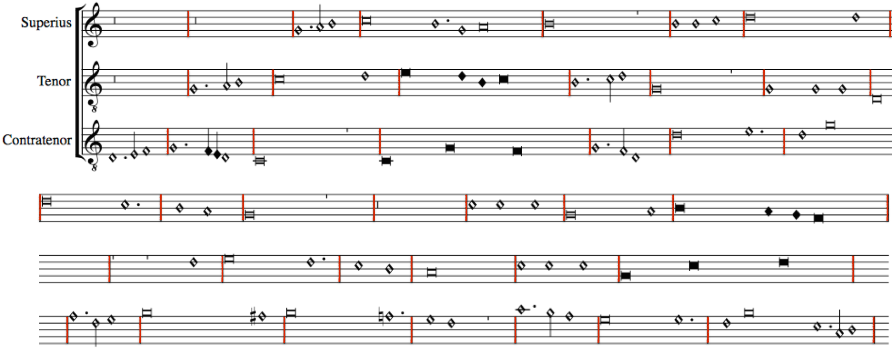
In Quasi-Score Format – Without Scoring-up Tool (notes are not aligned)
Notes:
STACK:
All the notes are interpreted as having the default duration given by the mensuration
No contextual or non-contextual modifications are shown because they are not encoded within the input files
If we were to use the ScUp tool instead, these modifications would be encoded and the piece would look like [CLICK]

Slide 24
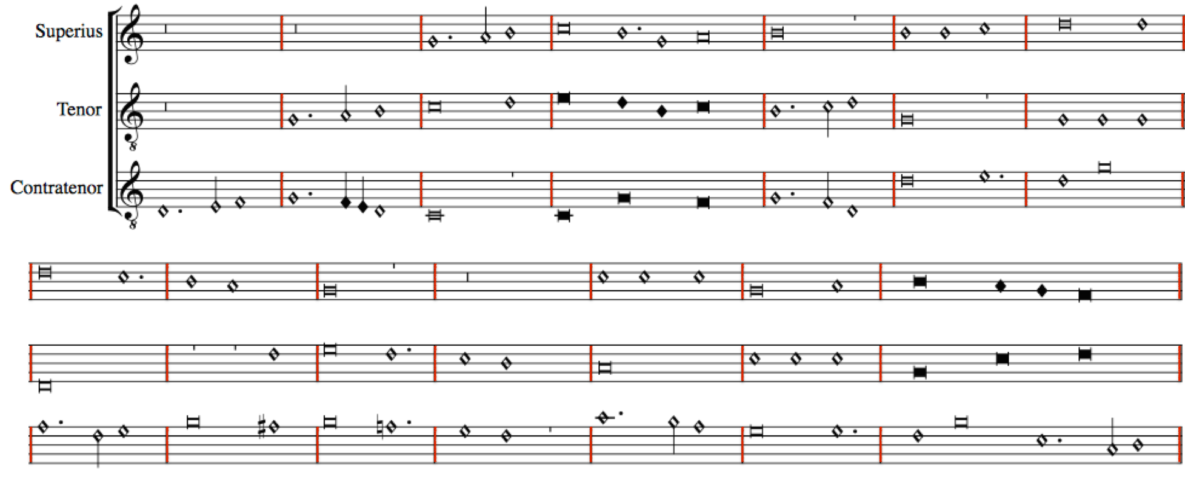
In Score Format – With Scoring-up Tool (modification values encoded)
Notes:
Show here:
The Imperfections
The Alterations
The coloration
The distinct dots

Slide 25
Conclusions
The scoring-up tool presents the piece in score format
Preserves the original note values
Facilitates visualizing the vertical sonorities and studying the relation between the voices of a piece
Notes:
[After 2] Making it faithful to the source, while providing additional information (regarding the vertical sonorities)
[After 3] which is obscured by the separate-parts layout of the original sources

Slide 26
Future Work
Pitch
Note shape
Mensural MEI file
_______
_______
Mensural Scoring-up
Tool
Determine note duration based on contextual and non-contextual cues
Merge all files together
OMR
Mensural
MEI file
________
________
________
________
Superius part
Mensural MEI file
_______
_______
OMR
Tenor part
SCORE
Mensural MEI file
_______
_______
OMR
Contratenor part
Notes:
Fully automate the process
Optical Music Recognition → MEI files that the Scup uses as input
Guatemalan MSS

Slide 27
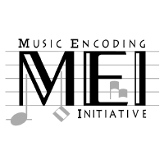
Thank you! https://github.com/elvis-project/scoring-up

Slide 28
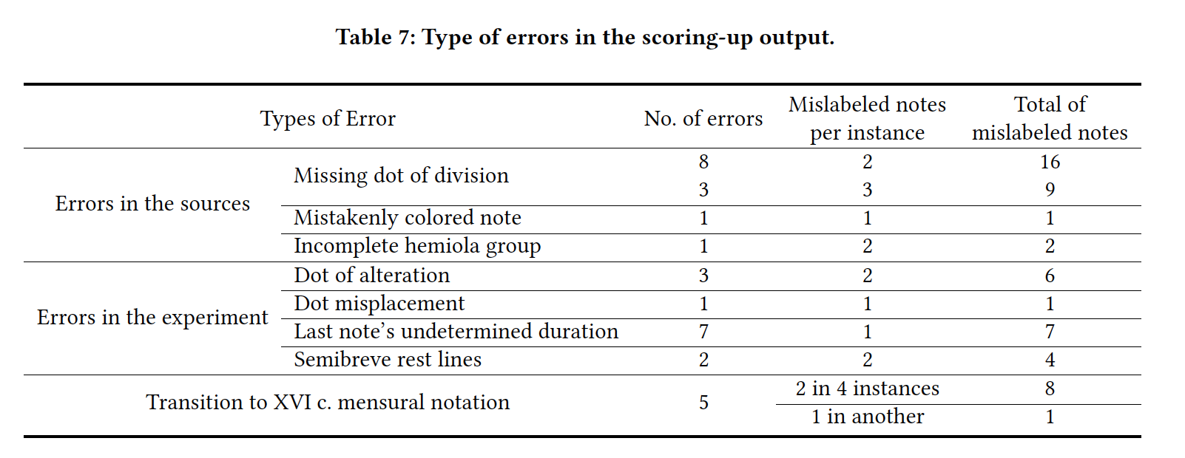

Slide 29
Sources of Error
Types of Error |  | Instances | Mislabeled Notes
Errors in the sources | Absence of a dot of division | 11 | 25
 | Others | 1 | 1
Errors in the experiment | Placement of the dot of division | 4 | 7
 | Last note | 7 | 7
 | Missing information regarding the staff-line in which a rest lies | 2 | 4
 | Others | 1 | 2
Errors due to situations out of the scope of the principles of imperfection and alteration |  | 5 | 9
 |  |  | 55

Slide 30
Absence of a dot of division

Slide 34
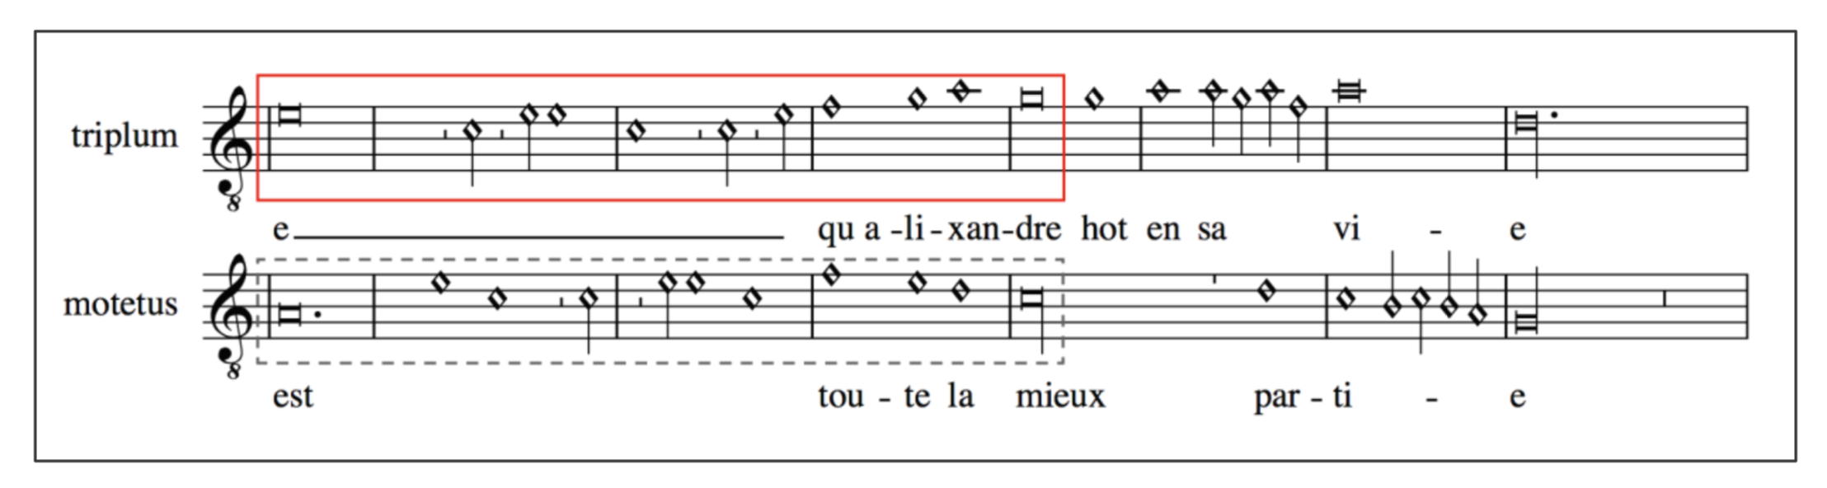

Slide 36
Placement of the dot of division

Slide 38
Last note

Slide 40
Missing information regarding the staff-line in which a rest lies

Slide 42
Errors due to situations out of the scope of the principles of imperfection and alteration

Slide 44
Other errors (sources)

Slide 45
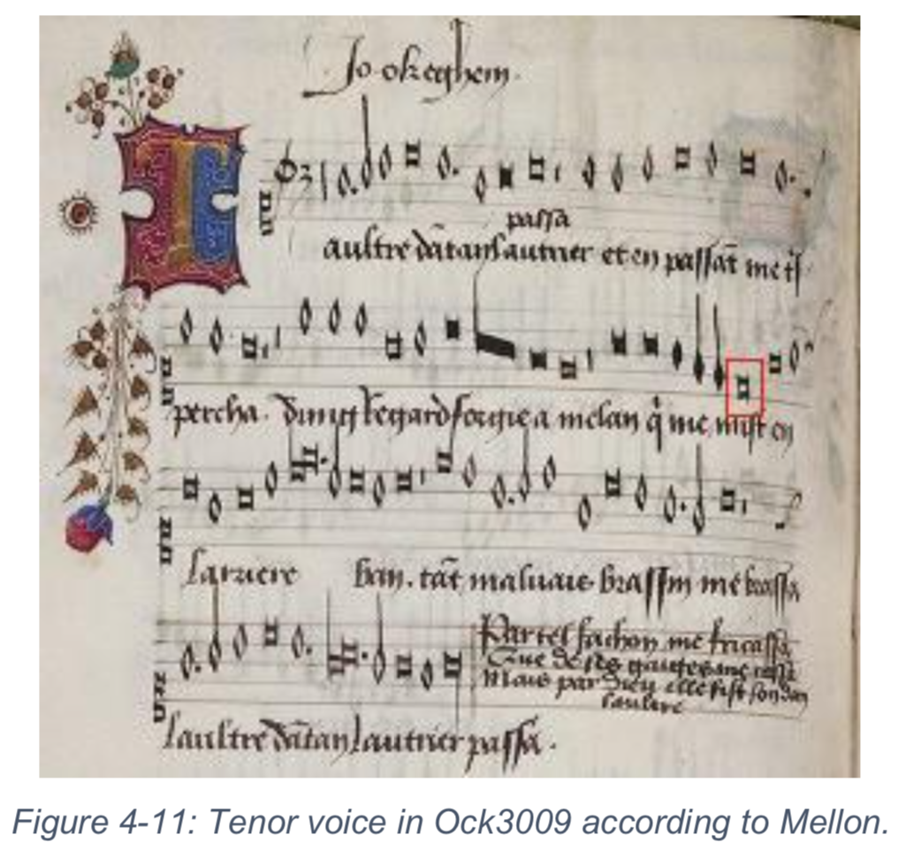

Slide 46
Other errors (experiment)

Slide 47
Incompleteness of hemiola group coloration

