Slide 1
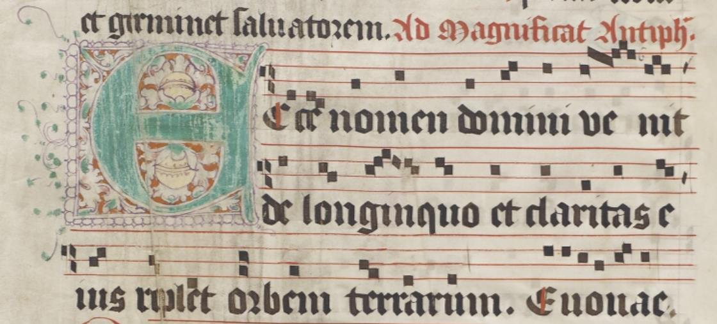
Differentiae Database http://differentiaedatabase.com
Username: admin
Password: Dalhousie2019
Rebecca Shaw
SIMSSA XIX (September 21, 2019)
r.shaw@utoronto.ca

Slide 2
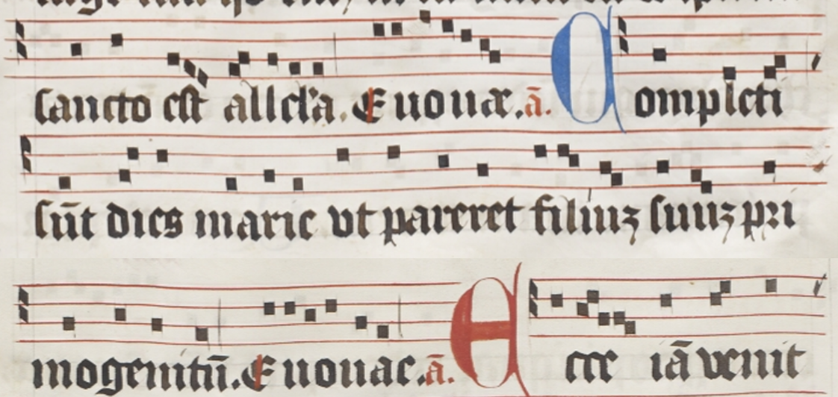
1 + 4
1. Antiphon
↓
[2. Psalm and Doxology]
↓
3. Differentia
↓
4. Antiphon
[2] + 3
Completi sunt dies marie, CDN-Hsmu M2149.L4, ff. 31r-31v
Slide 1
Notes:
Definition slides

Slide 3
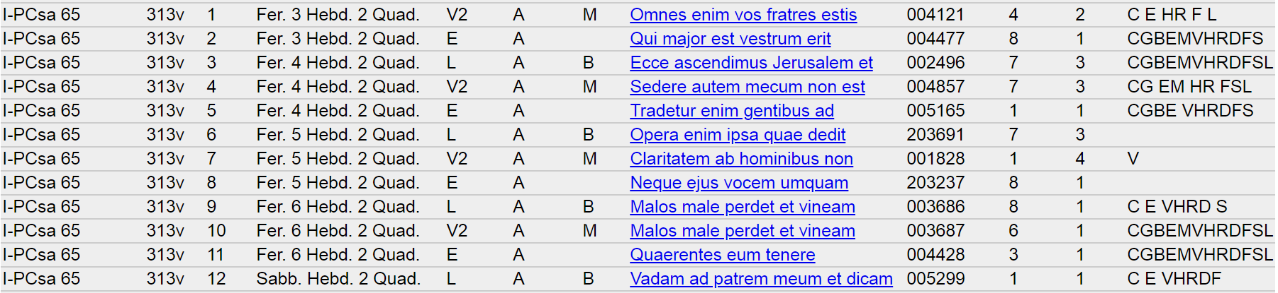
Siglum
Feast
Genre
Incipit
Mode
Concor-
dances
Folio
Office
CAO
Differentia
Slide 2
Notes:
Image: https://www.computerhope.com/jargon/p/punccard.htm
128 character limit

Slide 4
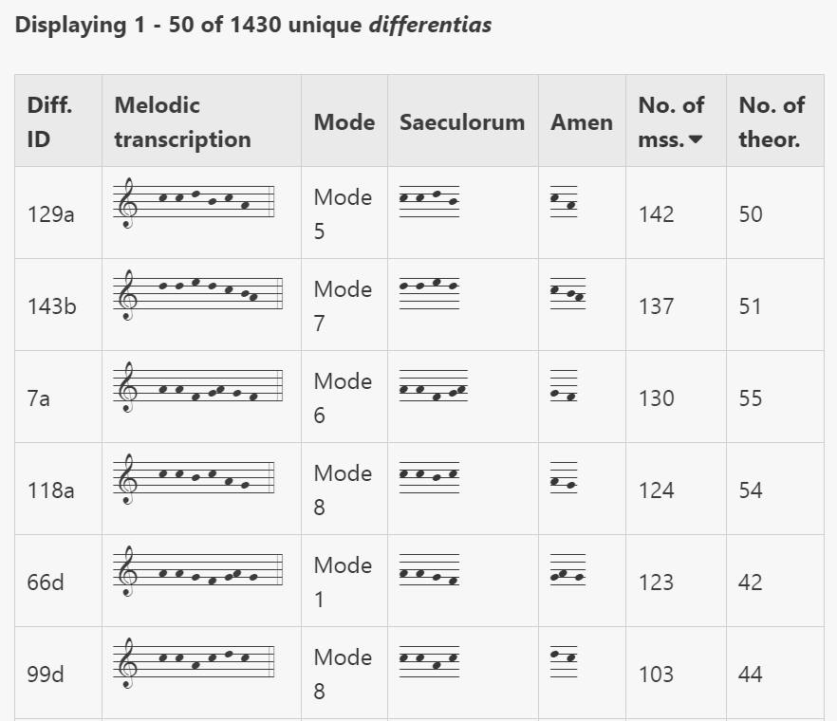
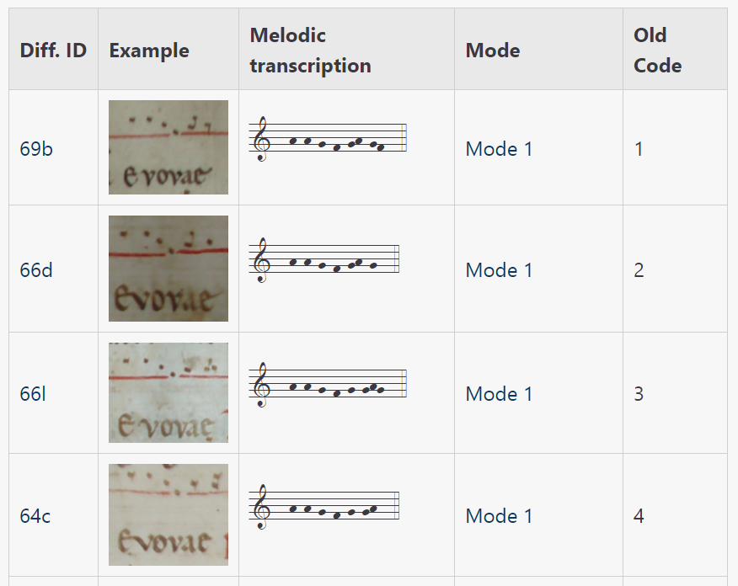
Differentiae
Database
Slide 3

Slide 5
Data Summary
159 manuscripts (1,258 unique differentiae)
61 theoretical treatises (435 unique differentiae)
1,457 unique differentiae
129,526 antiphons with standardized differentiae
Slide 4

Slide 6
Purpose and impact
provides a standardized means of indexing differentiae
enables the cross-manuscript study of differentiae
    clarify function of differentiae in antiphonal psalmody
    improve understanding of modally-ambiguous antiphons
    assist in identification of manuscript provenance
    understand the ‘medieval’ memorization and categorization of antiphon melodies
Slide 5

Slide 7
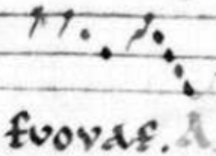
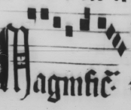

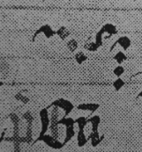
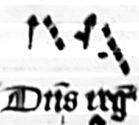

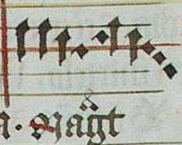
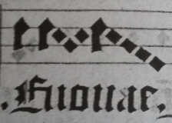
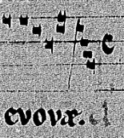
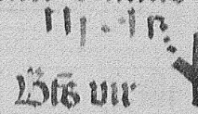
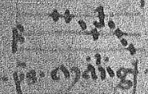
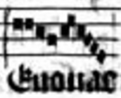
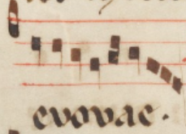
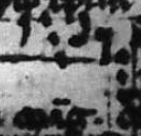
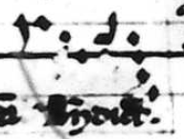
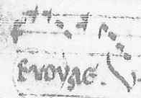

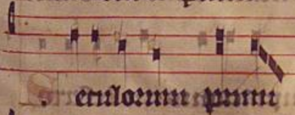
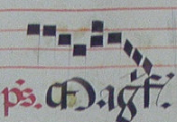
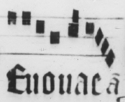
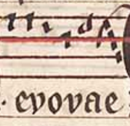

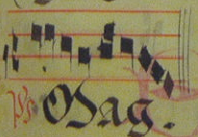

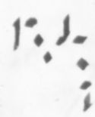
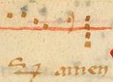

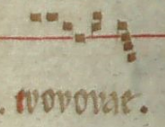
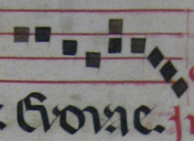
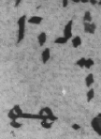

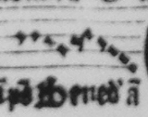
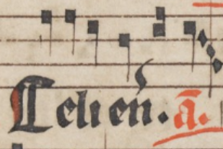

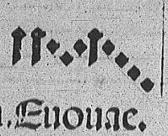
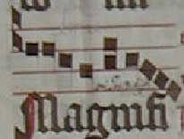
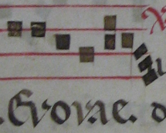
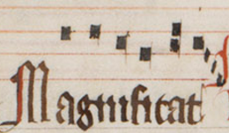

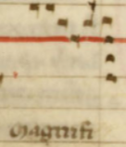

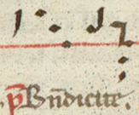
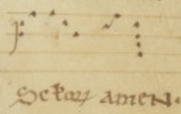
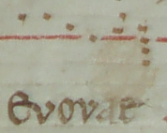
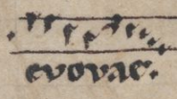
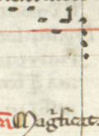
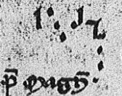
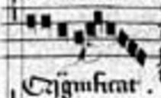
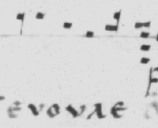
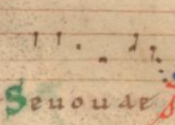
1--h-h-g-f-gh-gfed--4
D, 1, Da, 5, 4, 7, D1, D2g, D4, D2e, D1a, D01, ab, D3…
Slide 6
Notes:
example of all of the manuscripts with this differentia
82 manuscripts
30 theorists tonaries
mode 1

Slide 8
1--h-h-g-f-gh-gfed--4
72b
Slide 7
Notes:
example of all of the manuscripts with this differentia
82 manuscripts
30 theorists tonaries
mode 1

Slide 9
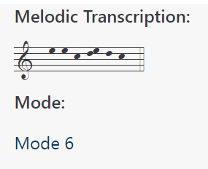
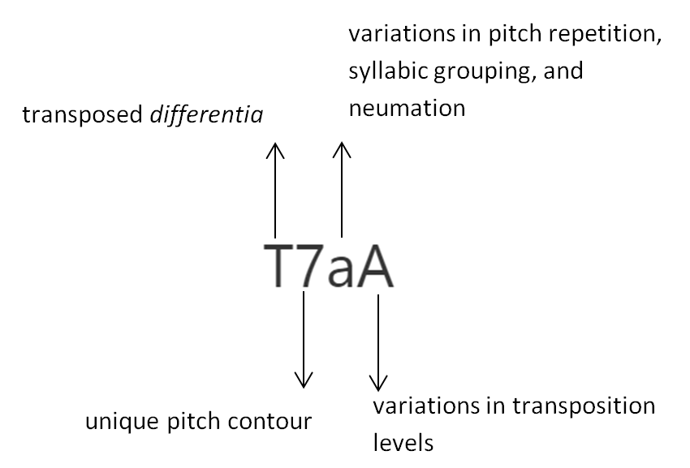
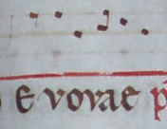
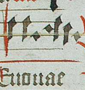

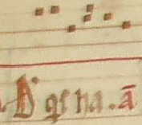





Slide 8
Notes:
Explanation of standardization system
T7aA – appears in 70 manuscripts
T7aB – starts on D; T7aC – starts on F (1 manuscript each)

Slide 10

Slide 9

Slide 11

Slide 10

Slide 12
Slide 11

Slide 13

Slide 12

Slide 14


provenance
century
monastic order or cathedral
male/female monastic order
style of notation
type of differentia
Slide 13
Notes:
Groups differentia found in manuscripts with this particular data set
Also summary of the Dominican manuscripts

Slide 15

standardized differentia ID
saeculorum
amen
mode
pitch contour
syllabic contour
direction of movement
interval of movement
range
inclusion of liquescents
transposition
Slide 14
Notes:
Differentiae Database – multiple access points, so that differentia and their relationships to each other, and their accompanying antiphons can be studied from multiple vantage points; multiple ways of assessing similarity and dissimilarity; ability to incorporate the standardized differentia ID into future manuscript indices

Slide 16

provenance
century
monastic order or cathedral
male/female monastic order
style of notation
type of differentia (in-line, margin, tonary letters)
Slide 15
Notes:
Differentiae Database – multiple access points, so that differentia and their relationships to each other, and their accompanying antiphons can be studied from multiple vantage points; multiple ways of assessing similarity and dissimilarity; ability to incorporate the standardized differentia ID into future manuscript indices

Slide 17
Impact and Significance
Enables cross-manuscript comparisons of differentiae
Existing definitions of differentiae are predominantly reliant on medieval theoretical sources
Provides answers to questions and contestations over differentia function and the relationship between differentiae, mode, and the melodic incipits of antiphons
Allows differentiae to be used in assessments of manuscript similarity and provenance, and studies of chant transmission
Slide 16
Notes:
Why standardize

Slide 18
Next steps
Finish editing manuscript differentiae
Launch public database
Add images for differentiae from theoretical sources and edit
Integrate the standardized differentiae IDs into Cantus Manuscript Database indices
Use standardized ID in future indices and continue adding manuscripts to the database
Slide 17

Slide 19

Thank you!
r.shaw@utoronto.ca

