Slide 1
IIIF AV Player
Andrew Kam

Slide 2
International Image Interoperability Framework
Community of leading research libraries and image repositories working together to produce a framework for image delivery
Provide scholars rich and uniform access to image-based resources, served directly from the originating organization’s systems
Define a set of common application programming interfaces that support interoperability
Develop technologies to provide a high-quality user experience in viewing, manipulating, and annotating images
Notes:
- Access to image-based resources is fundamental to research, scholarship and the transmission of cultural knowledge. Digital images are a container for much of the information content in the Web-based delivery of images, books, newspapers, manuscripts, maps, scrolls, single sheet collections, and archival materials. Yet much of the Internet’s image-based resources are locked up in silos, with access restricted to bespoke, locally built applications.
- IIIF is used for displaying images in SIMSSA project

Slide 3
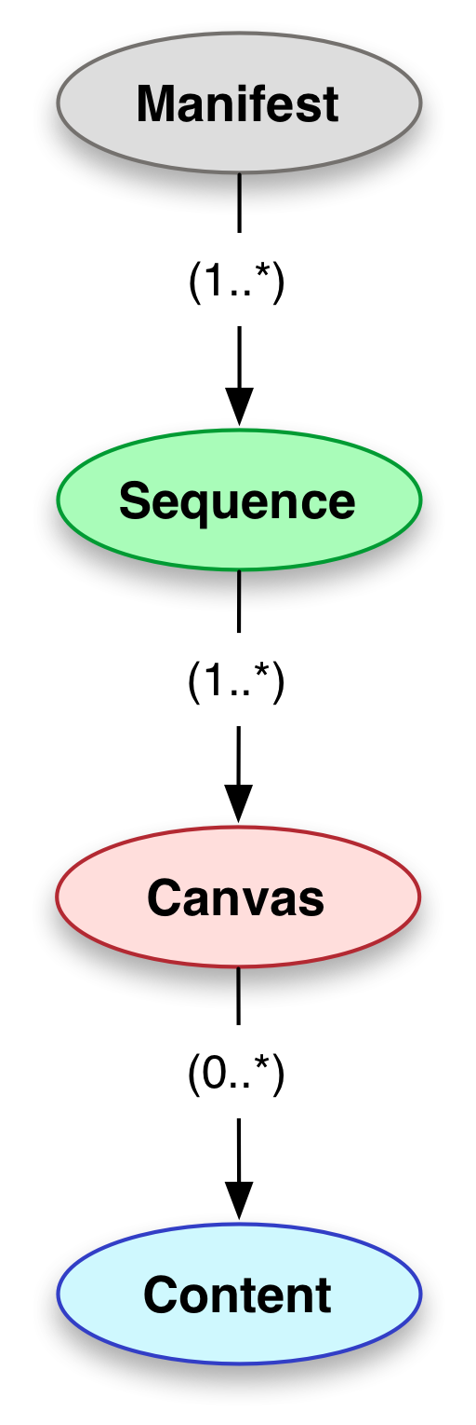
IIIF Presentation API 2.1.1
Display of digitized images associated with a particular physical object
Navigation between the pages, surfaces, or views of the object
Display of text or other metadata associated with the object or its pages
Notes:
Metadata - descriptive information about the object, labels that can aid navigation such as numbers associated with individual pages, copyright or attribution information, etc.
Examples - ancient scrolls to modern newspapers, from medieval manuscripts to online comics, and from large maps to small photographs. Many of them bear texts, sometimes difficult to read either due to the decay of the physical object or lack of understanding of the script or language

Slide 4
Musiclibs
https://musiclibs.net/

Slide 5
Musiclibs

Slide 6
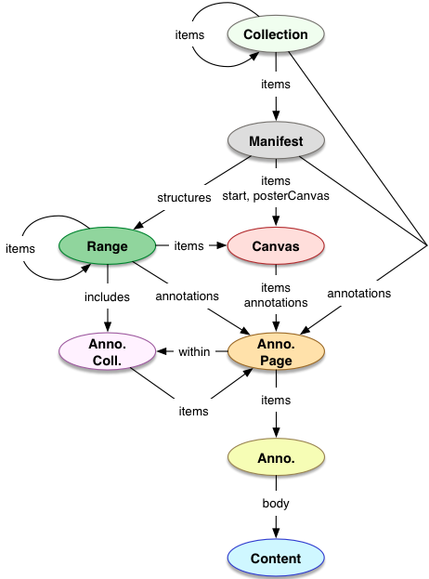
IIIF Presentation API 3.0
Add audio and video capabilities to the existing image framework
Functionality to navigate between multiple views or time extents of the object, either sequentially or hierarchically
Display descriptive information about the object, view, or navigation structure

Slide 7
IIIF AV Player
Proof-of-concept application that combines new IIIF AV functionality and MEI-encoded music notation to present a synchronized playback tool
Score-following application which allows libraries to align AV recordings with notated music
Using the Verovio notation renderer, users can interact with a dynamically-generated SVG in the browser
Developed in partnership with the British Library through the Save Our Sounds project
Funded by the Andrew W. Mellon Foundation
Notes:
- Save our Sounds is the British Library’s programme to preserve the nation’s sound heritage

Slide 8
https://ddmal.github.io/IIIF-AV-player/

Slide 9
AV Player Features
Ability to generalize to any video
User interface designed with ease of control and intuitiveness in mind
Looping functionality suitable for educational uses
Multiple canvases useful for musical performance comparison
Score-following timing created manually through tapping in Sonic Visualizer, with future plans to automate this task
Notes:
- Andrew Hankinson to present this application at the IIIF working meeting in Edinburgh next week

