Slide 1
Digital Analysis of Chant Transmission DACT
PI: Jennifer Bain, Dalhousie University
Project Manager: Debra Lacoste, University of Waterloo

Slide 2
Digital Analysis of Chant Transmission (DACT)
SSHRC, Partnership Development Grant

Slide 3
DACT Partners
Dalhousie University
McGill University
University of Manitoba
University of Waterloo
Fragmentarium
Cantus Planus in Polonia
Hungarian Chant Database
Musica Hispanica
Slovakian Early Music Database
Centro de Estudos de Sociologia e Estética Musical

Slide 4
DACT Co-Investigators
Ichiro Fujinaga, McGill University
Julie Cumming, McGill University
Kate Helsen, Western University
Mark Daley, Western University
James Maiello, University of Manitoba

Slide 5
DACT Collaborators
Andrew Hankinson
Michael Norton
Elsa De Luca
Inga Behrendt
Sarah Ann Long
Thomas Forrest Kelly
Barbara Haggh-Huglo
Terence Bailey
Christoph Fluëler
David Watt
Christine McWebb
Deantha Edmunds
Janice Tulk

Slide 6
Potential DACT Collaborators
Catherine Bradley (Univ. of Oslo) - Benedicamus Domino
Miriam Wendling (Leuven) - Requiem Mass chants
Tim Crawford (Goldsmiths) - similarity searches
Richard Haefer (Arizona State University) – national databases
Morne Bezuidenhout (University of Cape Town)
Dylan Robinson (Queen’s University)
Rebecca Shaw (University of Toronto)

Slide 7
Objectives
I: Establish Cantus Digital Network (CDN)
I: Establish Network Cantus

Slide 8
Objective I: Establish Network Cantus
Melody ID
OMR and MEI: SIMSSA and Cantus Ultimus

Slide 9
Objective II: Address two gaps
1. Transmission of chant outside of Europe
2. Transmission of chant through manuscript fragments

Slide 10
1: Transmission of chant outside Europe

Slide 11
Christian Kauder Buch das Gut 1866

Slide 12
Christian Kauder Buch das Gut 1866

Slide 13
Rituel du Diocese de Quebec Paris, 1703

Slide 14
Rituel du Diocese de Quebec Paris, 1703

Slide 15
Le Paroissien Noté, 2nd edition Québec, 1883

Slide 16
Pacifique de Valigny Le Paroissien Micmac Noté 1923

Slide 17
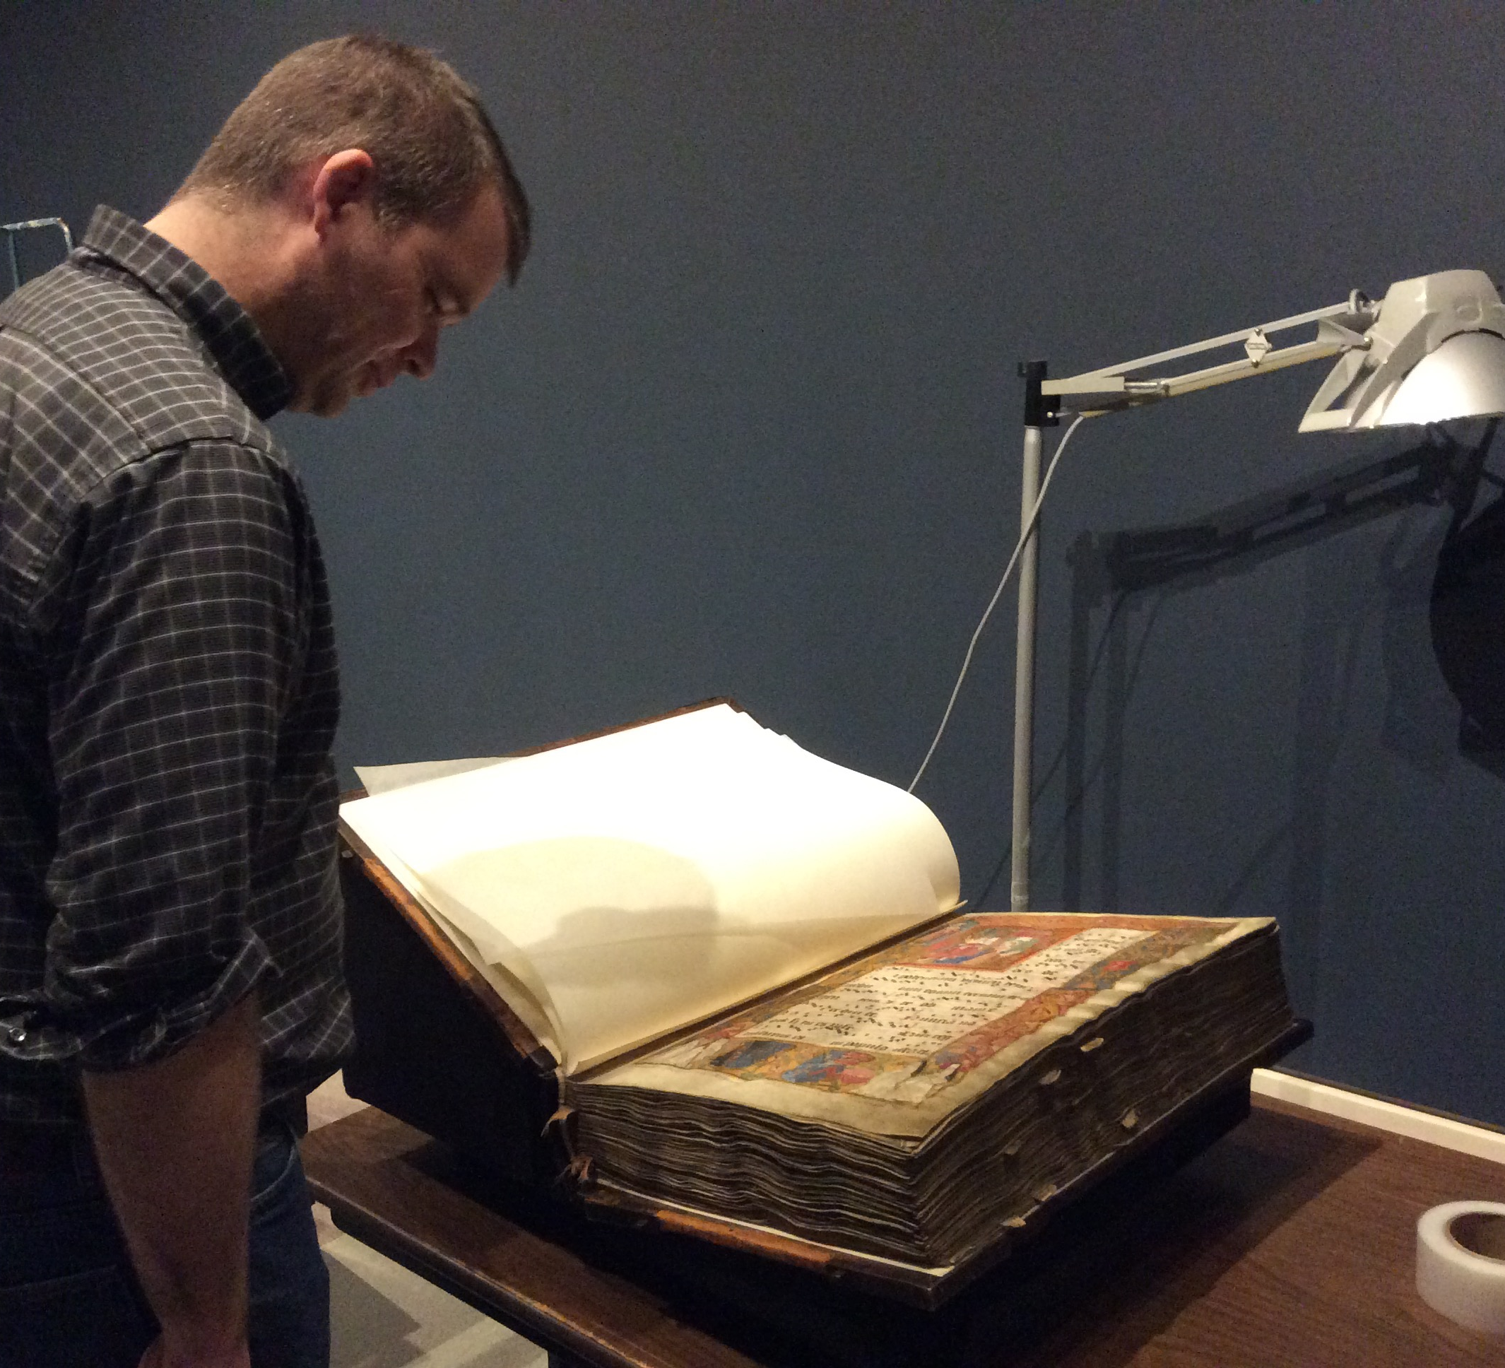
Andrew Hankinson Salzinnes Antiphonal 1554/55 Art Gallery of Nova Scotia

Slide 19
McGill Rare Books Collection

Slide 20
How do we deal with these materials? Build national chant databases in non-European countries CANADIAN CHANT DATABASE

Slide 21
Establish standards and protocols
Orthographies
Printed books
Recordings
Rebecca Shaw, MLIS and MA Musicology
“The Canadian Chant Database: A Proposal”

Slide 22
Establish standards and protocols
Indigenous materials
Ethics
Establishing relationships with communities
Formal agreements
Fallen Matthews, PhD student

Slide 23
Objective II: Address two gaps 2: Transmission of chant through MS fragments

Slide 26
Christoph Flüeler Fragmentarium.ms

Slide 27
Christoph Flüeler Fragmentarium.ms

Slide 28
Christoph Flüeler Fragmentarium.ms

Slide 29
Lisa Fagin Davis, Gottschalk Antiphoner Lambach Abbey, Austria

Slide 30
Lisa Fagan Davis, Gottschalk Antiphoner Lambach Abbey, Austria

Slide 31
Lisa Fagin Davis, Gottschalk Antiphoner Lambach Abbey, Austria

Slide 32
Lisa Fagin Davis, Gottschalk Antiphoner Lambach Abbey, Austria

Slide 33
Bring together catalogue and images?

Slide 34
Cantus Ultimus: cantus.simssa.ca

Slide 35
Next steps
Chant fragments already on Fragmentarium:
Inventory on Cantus Database (full text and music)
McGill and other chant fragments in Canadian collections:
Create files and describe on Fragmentarium
Inventory on Cantus Database (full text and music)
Bring together on Cantus Ultimus
Launch Social Media campaign

Slide 36
Jennifer Bain, Dalhousie University
bainj@dal.ca

Slide 38
Fragments
Jennifer Bain, Dalhousie University

Slide 39
Plan for Fragments

Slide 40
Fragmentarium - Phase 1

Slide 41
Fragmentarium - Phase 2

Slide 47
Chant fragment description?
Rebecca Shaw, "The Canadian Chant Database: a Proposal," 2019
Musical and text elements:
Number of staff lines
Number of staves per page
Coloured lines
Notation type
Colour of text
Colour of initials

Slide 48
Interoperability?
Rebecca Shaw, “Protocols for Manuscript and Fragment Identification: Proposal,” 2019
DACT ID – 3 parts
(1) Database identifier for original location of information (e.g., “F” for Fragmentarium, “CD” for the Cantus Database, “CU” for Cantus Ultimus, etc.).
(2) A computer-generated, four-digit alphanumeric code unique.

Slide 49
DACT ID cont.
(3) An alphabetic suffix to indicate whether the record is a:
D = manuscript or fragment description
I = complete manuscript or fragment inventory
C = individual chant record within the manuscript or fragment, followed by the folio and sequence number, as entered in the Cantus Database
F = digital facsimile of the manuscript or fragment

Slide 50
DACT ID cont.
Salzinnes Antiphonal:
Cantus Database description: CD-g7jk-D
Cantus Database inventory: CD-g7jk-I
Manuscript images, hosted on Cantus Ultimus: CU-g7jk-F
Responsory Ascipiens a longe ecce video, the first chant on f. 2r, would be CD-g7jk-C.002r.1

Slide 51
Next steps
Chant fragments already on Fragmentarium:
Inventory on Cantus Database (full text and music)
McGill and other chant fragments in Canadian collections:
Create files and describe on Fragmentarium
Inventory on Cantus Database (full text and music)
Bring together on Cantus Ultimus
Launch Social Media campaign

Slide 52
Jennifer Bain, Dalhousie University
bainj@dal.ca

